Slide 1

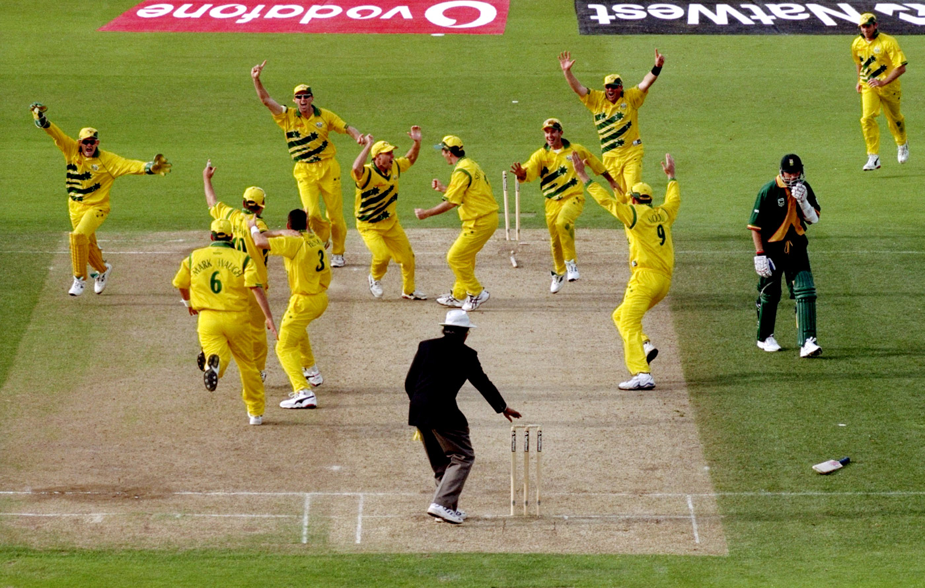
ONE DAY CRICKET MATCHES
EXPLORATORY DATA AND CLASSIFICATION ANALYSIS ON ONE DAY CRICKET MATCHES
BY ROHIT SUBRAMANIAM

Slide 2
agenda
1. BUSINESS/DATA QUESTIONS
3. PROJECT PIPELINE
4. RESULTS
5. SUMMARY
6. CONCLUSIONS AND FURTHER WORK
2. PERFORMANCE TRENDS

Slide 3
BUSINESS QUESTION
1. Impact of winning toss on team winning?
DATA QUESTION
1. What are the characteristics of the dataset?
2. Which model accurately reflects home ground on home team performance?
Stakeholder(S)
1. Performance Analyst, Cricket Australia, Cricket Victoria, Sports Analyst and Champion Data.

Slide 4
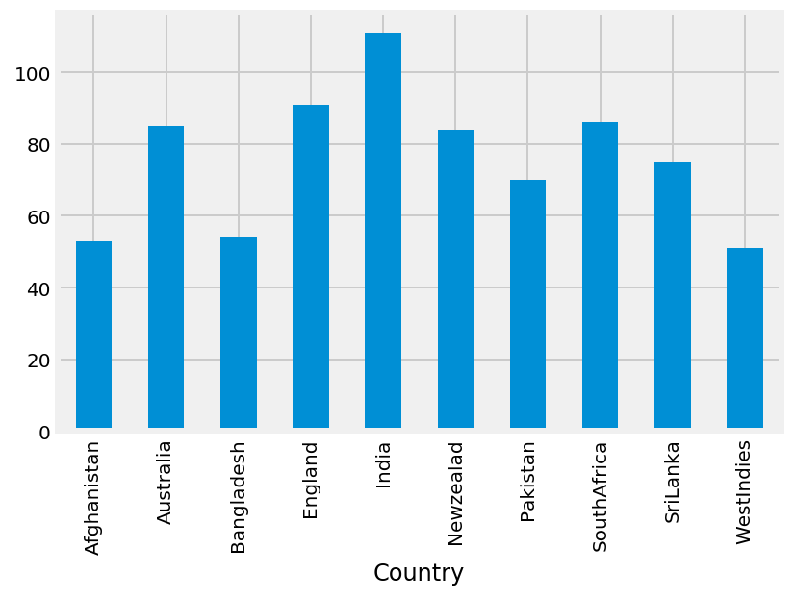
Performance trends
Figure 1: Number of wins scored by each country from 2013 to 2019

Slide 5
PROJECT PIPELINE
Background context
Stakeholders
Business and data questions
Business and Data Answers
Imported world cup dataset
Data Analysis
Key Variable Selections
CLASSIFICATION AND ENCODING
CONCLUSIONS

Slide 6
KEY VARIABLES SELECTED AND CREATED
Selected – Margin, Bat and Bonus runs.
Created – Binary variables toss won and team won.

Slide 7
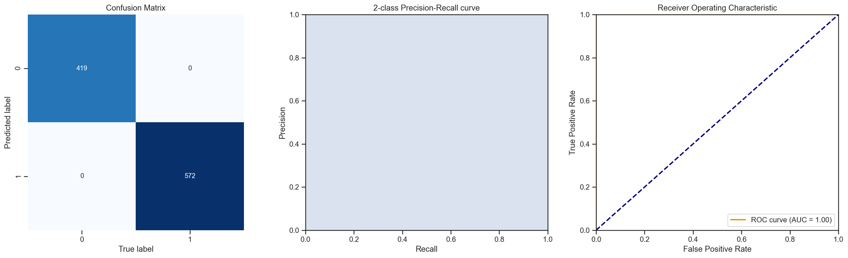
RESULTS OF decision tree classification
Figure 2: Results for Decision Tree Classification using training data set.

Slide 8
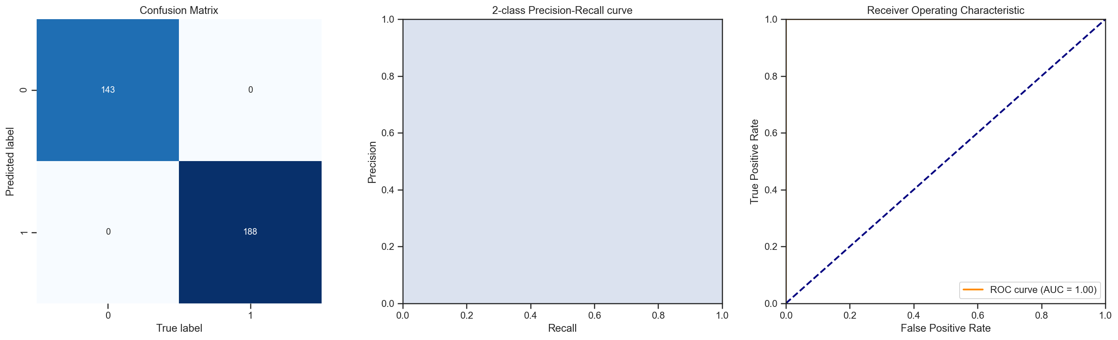
RESULTS OF decision tree classification (CONT*)
Figure 3: Results for Decision Tree Classification using test data set.

Slide 9
RESULTS OF DECISION TREE CLASSIFICATION (CONT*)
 | Accuracy | Precision | Recall | ROC AUC
Test data | 1.00 | 1.00 | 1.00 | 1.00
Training data | 1.00 | 1.00 | 1.00 | 1.00
Table 1: Performance of Decision tree classification

Slide 10
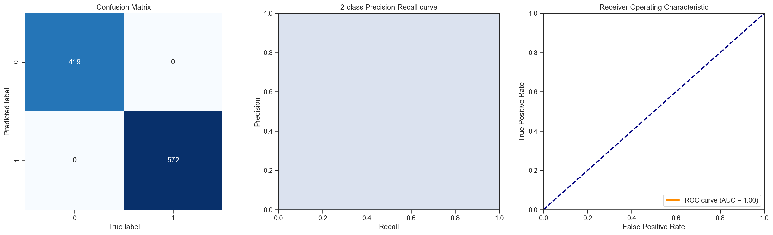
RESULTS OF RANDOM FOREST classification
Figure 4: Results for Random Forest Classification using training data set.

Slide 11

RESULTS OF RANDOM FOREST classification (CONT*)
Figure 5: Results for Random Forest Classification using test data set.

Slide 12
RESULTS OF RANDOM FOREST CLASSIFICATION (CONT*)
 | Accuracy | Precision | Recall | ROC AUC
Test data | 1.00 | 1.00 | 1.00 | 1.00
Training data | 1.00 | 1.00 | 1.00 | 1.00
Table 2: Performance of Random Forest classification

Slide 13
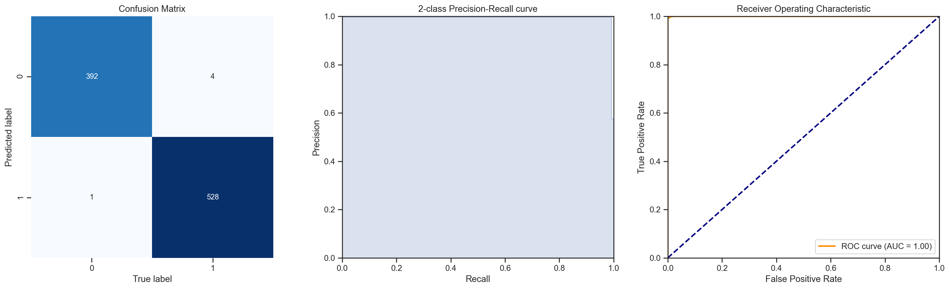
RESULTS OF BAGGING classification
Figure 6: Results for Decision Tree

Slide 14

RESULTS OF BAGGING classification (CONT*)
Figure 7: Results for Bagging (Decision Tree)

Slide 15
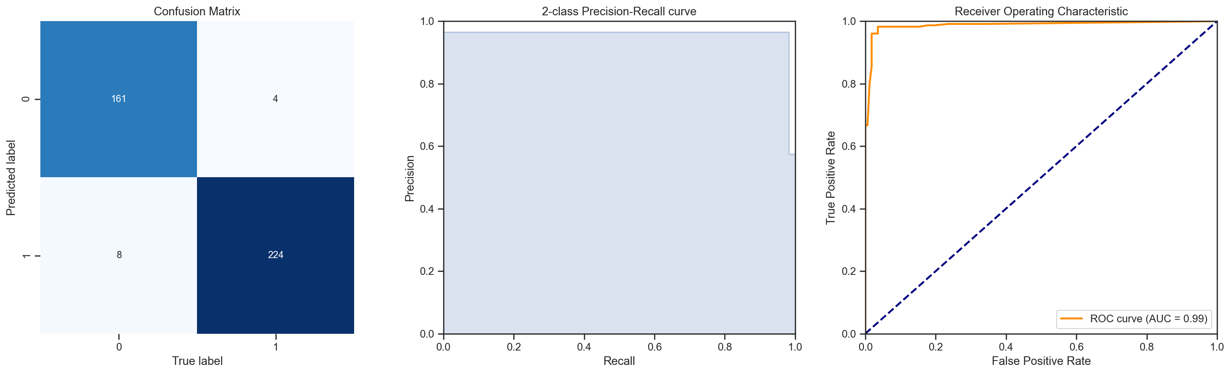
RESULTS OF BAGGING classification (CONT*)
Figure 8: Results for Bagging (with test)

Slide 16
RESULTS OF BAGGING classification (CONT*)
Model | Accuracy | Precision | Recall | ROC AUC
Decision Tree | 0.994595 | 0.998110 | 0.992481 | 0.999931
Bagging (DT) | 0.994595 | 0.994371 | 0.996241 | 0.999897
Bagging (with test) | 0.969773 | 0.965517 | 0.982456 | 0.987776
Table 3: Performance of Random Forest classification
Table 3: Performance of Bagging classification

Slide 17
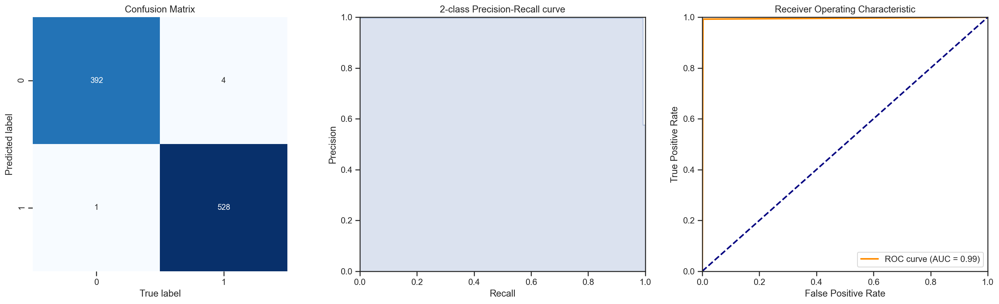
RESULTS OF ADAPTIVE BOOSTING classification
Figure 9: Results for Decision Tree

Slide 18
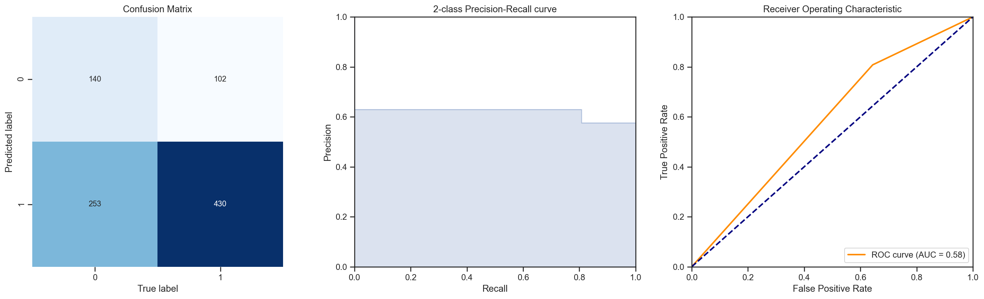
RESULTS OF ADAPTIVE BOOSTING classification (CONT*)
Figure 10: Results for Adaptive Boosting

Slide 19
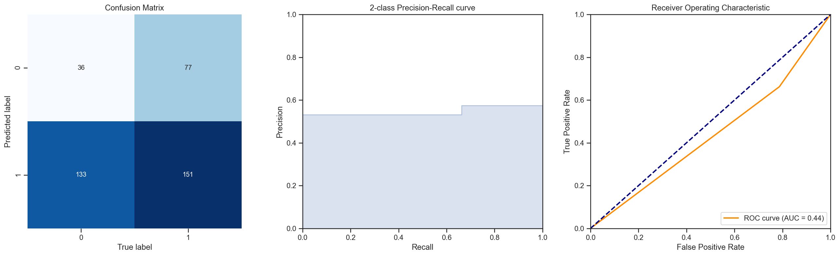
RESULTS OF ADAPTIVE BOOSTING classification (CONT*)
Figure 11: Results for Adaptive Boosting (with test)

Slide 20
RESULTS OF ADAPTIVE Boosting classification (CONT*)
Model | Accuracy | Precision | Recall | ROC AUC
Decision Tree | 0.994595 | 0.998110 | 0.992481 | 0.994968
AdaBoost | 0.616216 | 0.629575 | 0.808271 | 0.582252
AdaBoost (with test) | 0.471033 | 0.531690 | 0.662281 | 0.437649
Table 3: Performance of Random Forest classification
Table 4: Performance of Adaptive Boosting classification

Slide 21
SUMMARY
DATA
METHOD
OUTCOMES
* Data consists of both categorical and numerical variables.
* Imported one day cricket dataset
* Created variables, Team Won and Toss Won.
* Imputed variable, ‘BR.’
* Used appropriate modelling and encoding to identify effect of winning toss on team performance.
* All four classification methods have shown the impact of winning toss on team winning or losing.
* Logistic, Support Vector Machine and Naïve Bayesian classifier have shown no impact of winning toss on team winning or losing.
* Data consists 1322 entries from 2013-2019
* Only the variable ‘BR’ has 2 null values.

Slide 22
CONCLUSIONS
* Winning toss along with batting first or second, margin and bonus runs impact team performance.
FURTHER WORK
* Impact of weather conditions on team performance.
* Home ground advantages.

